Slide 1
Welcome to the Spektrix Patterns Group
Factory Method

Slide 2
Agenda
1 hour approximately
Introduction to Factory Method and brief demonstration - 10 minutes
Split into groups for discussion - 20 minutes
Retro - 20 mins

Slide 3
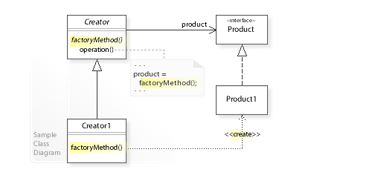
Factory Method
The Creator class that requires a Product object doesn't instantiate the Product1 class directly.
Instead, the Creator refers to a separate factoryMethod()to create a product object

Slide 4
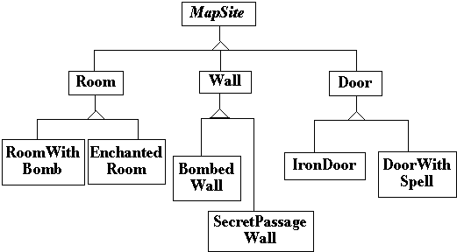
Maze Game Example

Slide 5
Questions
How does Factory Method promote loosely coupled code?
Discuss some examples of where you have seen this pattern in your projects.
How does Factory Method help us adhere to the SOLID priciples?

Slide 6
Next Session
Let’s talk about… Strategy Pattern

